Slide 1
Computer Science
Recurrence Relations
Samuel Lukas

Slide 2
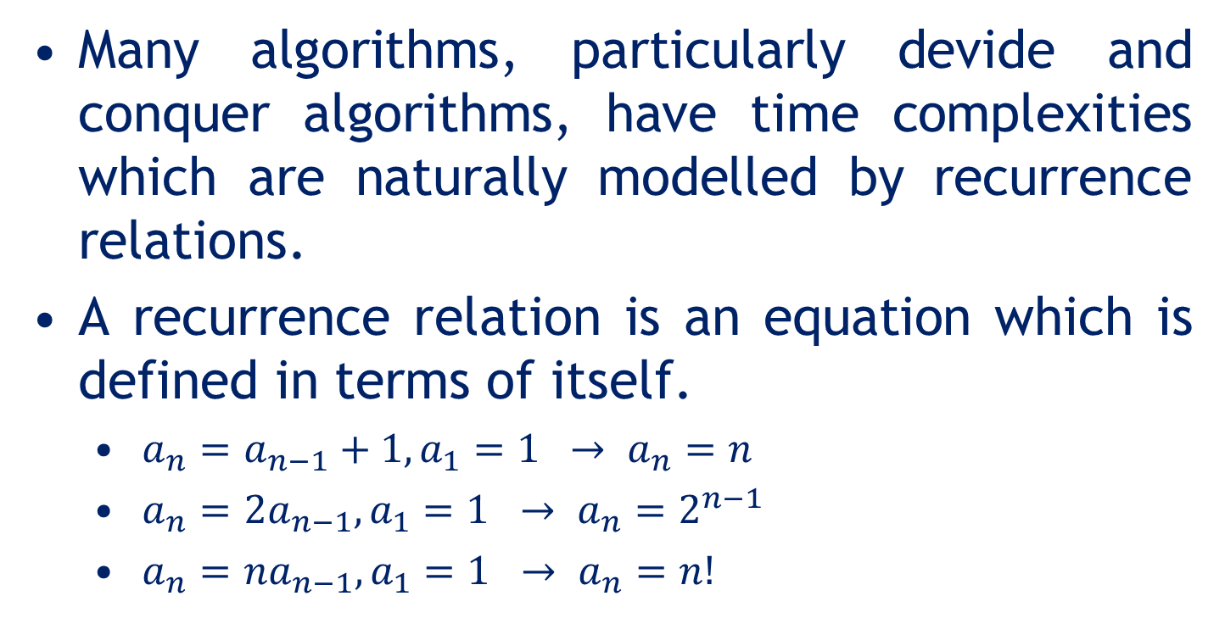
Introduction
Many algorithms, particularly devide and conquer algorithms, have time complexities which are naturally modelled by recurrence relations.
A recurrence relation is an equation which is defined in terms of itself.
$a_{n}=a_{n−1}+1, a_{1}=1 → a_{n}=n$
$a_{n}={2a}_{n−1}, a_{1}=1 → a_{n}=2^{n−1}$
$a_{n}={na}_{n−1}, a_{1}=1 → a_{n}=n!$

Slide 3
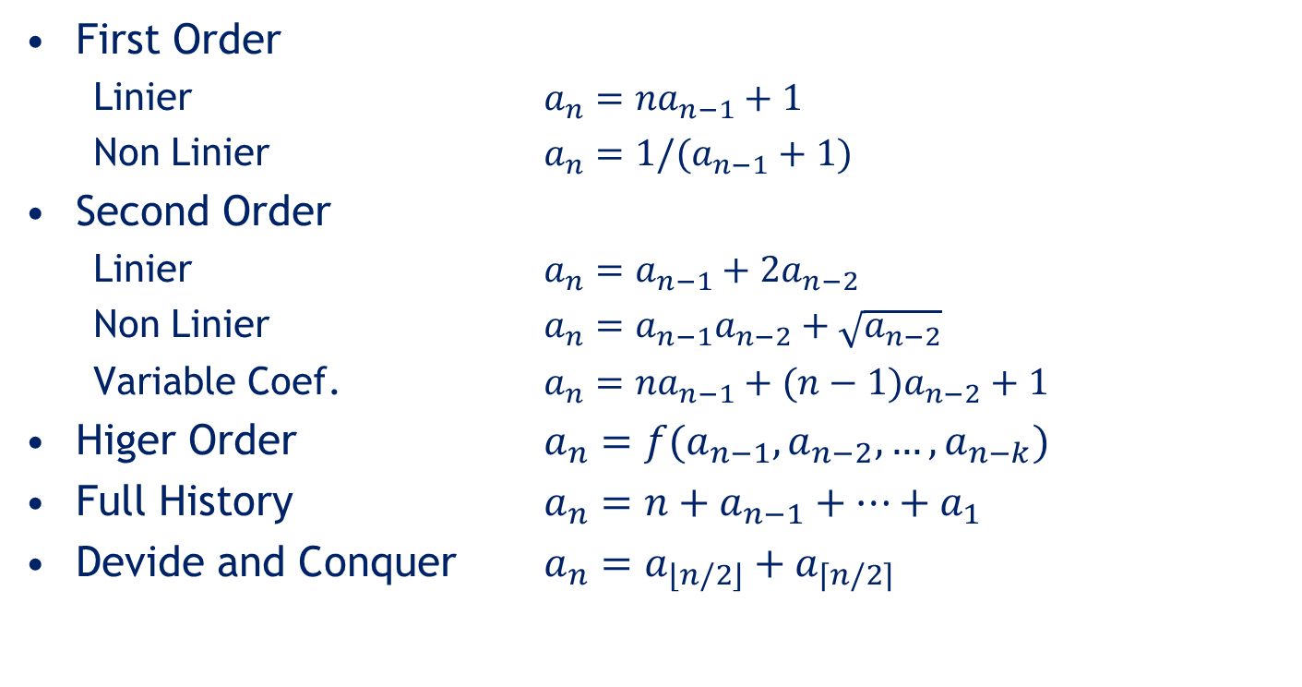
Type of recurrences
First Order
Linier $a_{n}={na}_{n−1}+1$
Non Linier $a_{n}={1/(a}_{n−1}+1)$
Second Order
Linier $a_{n}=a_{n−1}+2a_{n−2}$
Non Linier $a_{n}=a_{n−1}a_{n−2}+\sqrt{a_{n−2}}$
Variable Coef. $a_{n}={na}_{n−1}+(n−1)a_{n−2}+1$
Higer Order $a_{n}={f(a}_{n−1},a_{n−2},…,a_{n−k})$
Full History $a_{n}={n+a}_{n−1}+…+a_{1}$
Devide and Conquer $a_{n}=a_{\left\lfloor n/2\right\rfloor }+a_{\left\lceil n/2\right\rceil }$

Slide 4
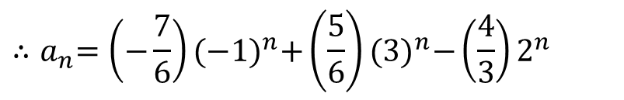
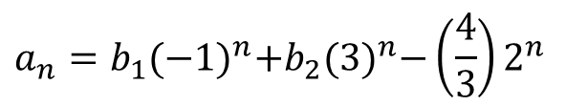
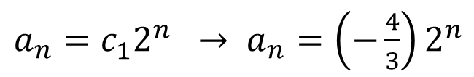

Solving Recurrences
Linier, constant coefficient recurrences, mathematically always can be solved
$$a_{n}={2a}_{n−1}+3a_{n−2}+2^{n}, a_{1}=1, a_{2}=1$$
Homogen :
$a_{n}={2a}_{n−1}+3a_{n−2 }→ r^{2}=2r+3 →r=\{−1,3\}$
$${∴a}_{n}=b_{1}^{}{(−1)}^{n}+b_{2}^{}3^{n}$$
Particular solution :
$a_{n}=c_{1}^{}2^{n} → a_{n}=\left(−\frac{4}{3}\right)2^{n}$
$$a_{n}={b_{1}{(−1)}^{n}+b}_{2}{(3)}^{n}−\left(\frac{4}{3}\right)2^{n}$$
$${∴a}_{n}=\left(−\frac{7}{6}\right){(−1)}^{n}+\left(\frac{5}{6}\right){(3)}^{n}−\left(\frac{4}{3}\right)2^{n}$$

Slide 5






Example 01
Find the big O of an algorithm which has number of steps is
$$T\left(n\right)=2 T\left(n−1\right)+1, T\left(0\right)=0$$
$$T_{n}=2T_{n−1}+1$$
$$→r=2 → T_{n}=b_{1}^{}2^{n}$$
$$T_{p}=C → C=2C+1 → C=−1$$
$$∴T_{n}=b_{1}^{}2^{n} −1$$
$${n=0 → T}_{0}=b_{1}^{} −1=0 → b_{1}=1$$
$$∴T_{n}=2^{n} −1$$
$$∴T\left(n\right)=O(2^{n})$$

Slide 6




Example 01 (cont)
Find the big O of an algorithm which has number of steps is
$$T\left(n\right)=2 T\left(n−1\right)+1, T\left(0\right)=0$$
$$T_{n}=2{(2T}_{n−2}+1)+1$$
$$→ T_{n}=2^{2}T_{n−2}+3$$
$$T_{n}=2^{2}\left(2T_{n−3}+1\right)+3 → T_{n}=2^{3}T_{n−3}+2^{2}+2+1$$
$$T_{n}=2^{n}T_{0}+2^{n−1}+2^{n−2}+…+1$$
$$T_{n}=2^{n−1}+2^{n−2}+…+1$$
$$∴T_{n}=2^{n} −1$$
$$∴T\left(n\right)=O(2^{n})$$

Slide 7


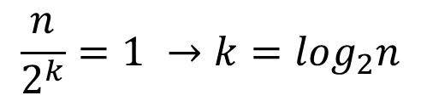

Example 02
Find the big O of an algorithm which has number of steps is
$$T\left(n\right)= T\left(n/2\right)+c_{1} , T\left(1\right)=c_{2}$$
Binary search model
$$T\left(n\right)=\left(T\left(n/4\right)+c_{1}\right)+c_{1}=T\left(n/4\right)+2c_{1}$$
$$T\left(n\right)=\left(T\left(n/8\right)+c_{1}\right)+{2c}_{1}=T\left(n/8\right)+3c_{1}$$
$$T\left(n\right)=T\left(n/2^{k}\right)+kc_{1}$$
$$\frac{n}{2^{k}}=1 →k=\log_{2}n$$
$$∴T\left(n\right)=T\left(1\right)+{(log}_{2}n)c_{1}$$
$T\left(n\right)=c_{2}+c_{1}{(log}_{2}n)→ T\left(n\right)=O{(log}_{2}n)$

Slide 8
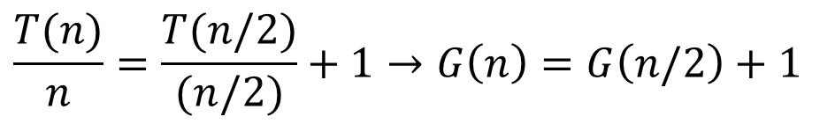

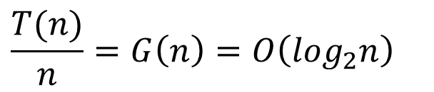
Example 03
Find the big O of an algorithm which has number of steps is
$$T\left(n\right)=2T\left(n/2\right)+n , T\left(1\right)=0$$
Mergesort model
$$\frac{T(n)}{n}=\frac{T(n/2)}{(n/2)}+1→G\left(n\right)=G\left(n/2\right)+1$$
$$\frac{T(n)}{n}=G\left(n\right)=O\left(\log_{2}n\right)$$
$∴T\left(n\right)=O(n{(log}_{2}n))$

Slide 9
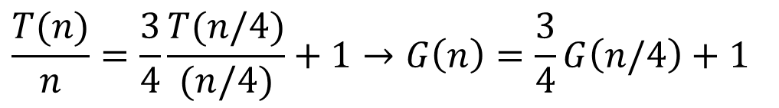

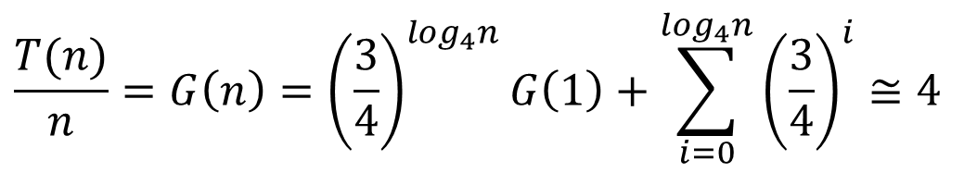
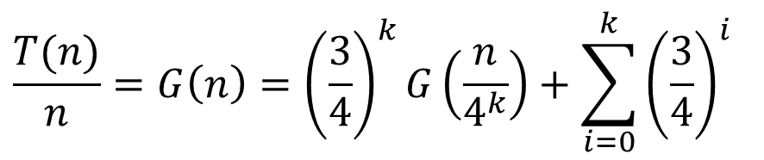
Example 04
Find the big O of an algorithm which has number of steps is
$$T\left(n\right)=3T\left(n/4\right)+n , T\left(1\right)=0$$
$$\frac{T(n)}{n}=\frac{3}{4}\frac{T(n/4)}{(n/4)}+1→G\left(n\right)=\frac{3}{4}G\left(n/4\right)+1$$
$$\frac{T(n)}{n}=G\left(n\right)={\left(\frac{3}{4}\right)}^{k}G\left(\frac{n}{4^{k}}\right)+\sum_{i=0}^{k}{{\left(\frac{3}{4}\right)}^{i}}$$
$$\frac{T(n)}{n}=G\left(n\right)={\left(\frac{3}{4}\right)}^{\log_{4}n}G\left(1\right)+\sum_{i=0}^{\log_{4}n}{{\left(\frac{3}{4}\right)}^{i}}≅4$$
$∴T\left(n\right)=O(n$)

